Slide 1
Embedding Participation in Flood ABM
Rok Novak, Maria Alejandra Rubio, David Kocman
Jožef Stefan Institute; SSC 2026, Durham

Slide 2
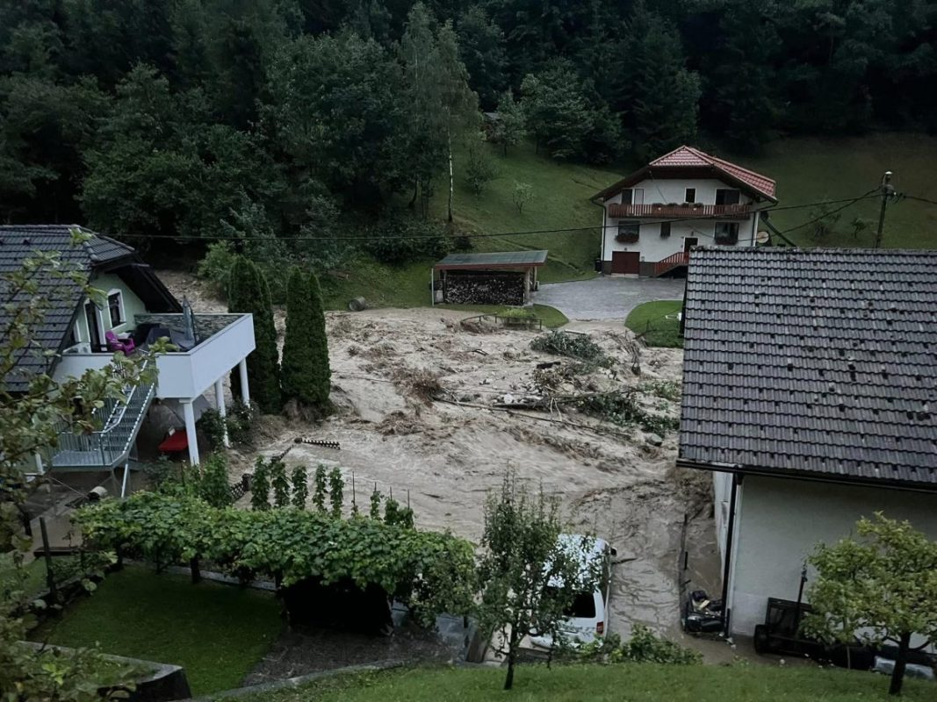
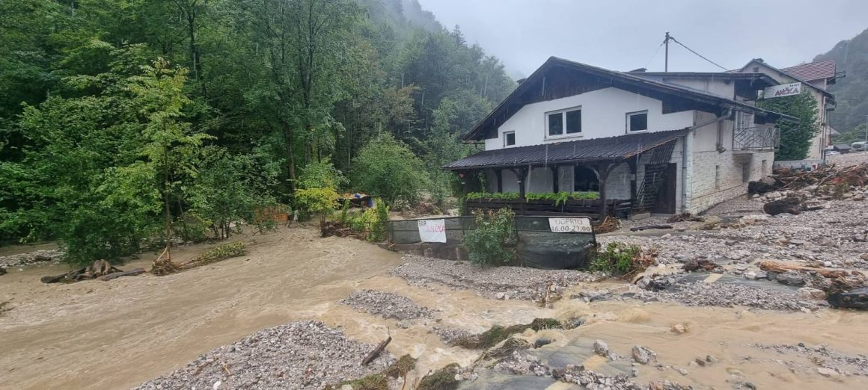
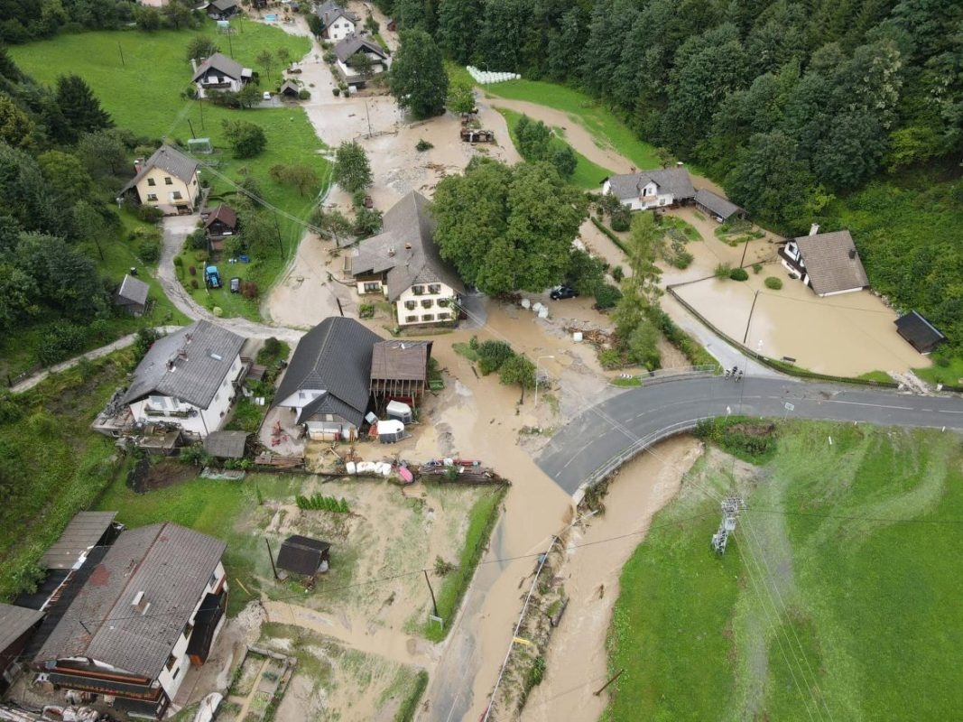
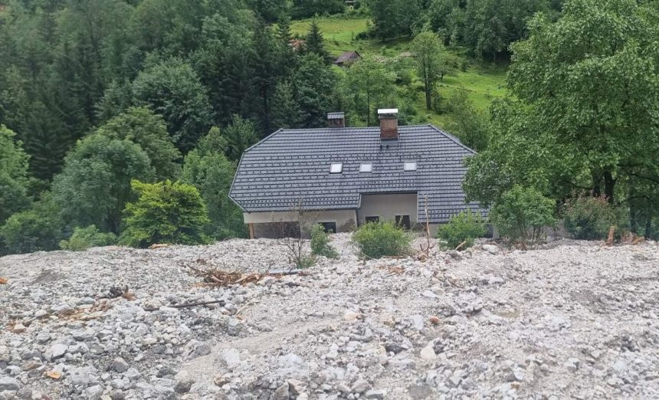

Slide 3
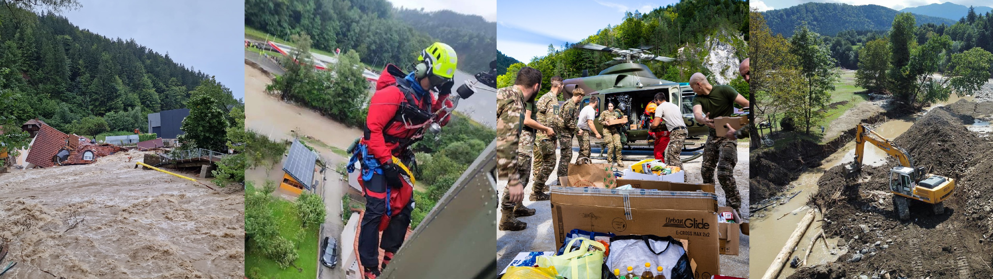
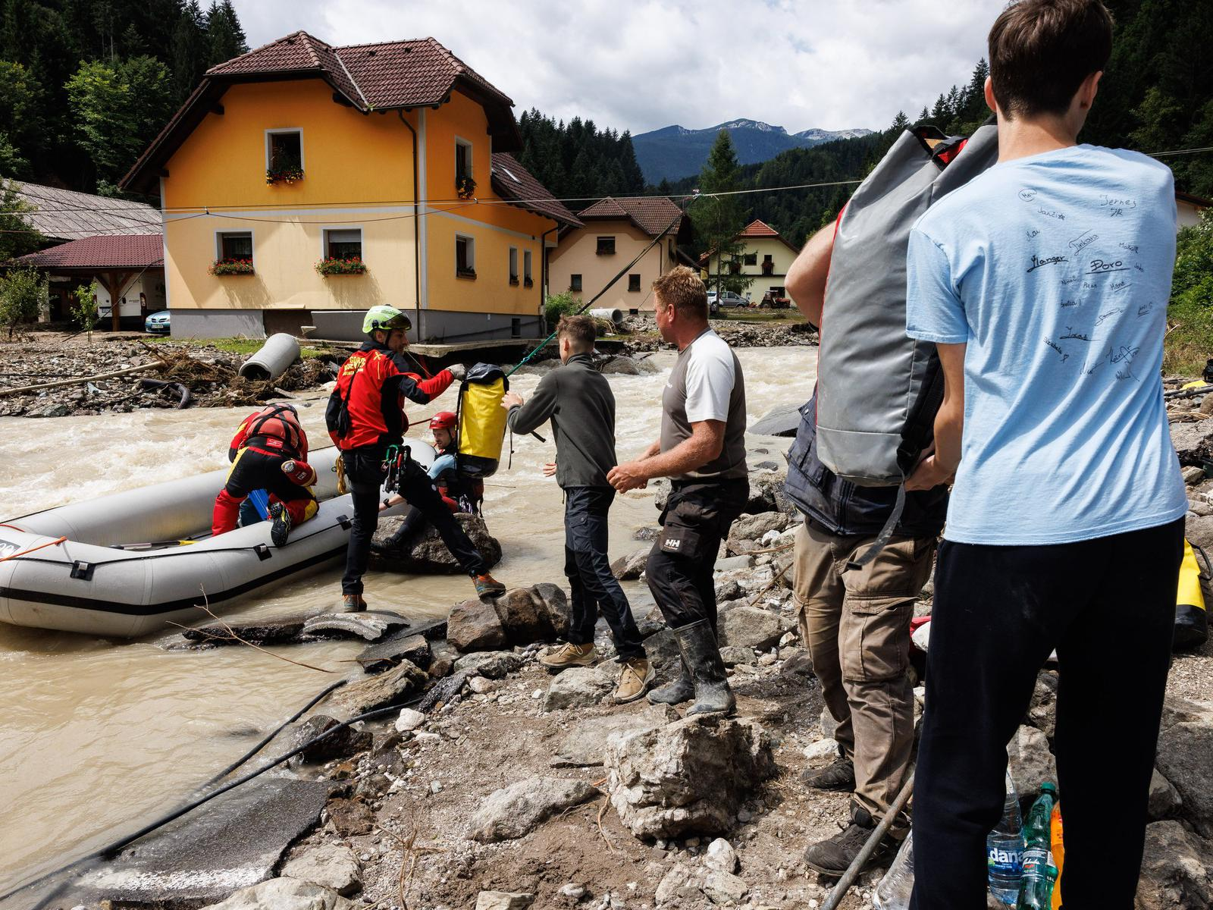
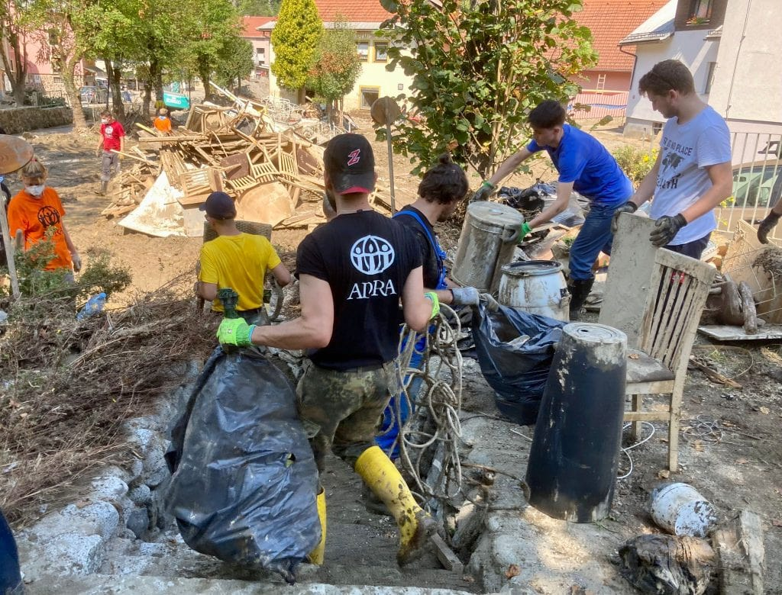
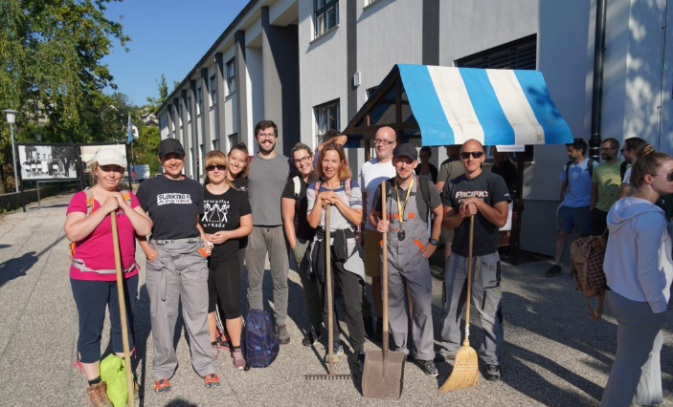

Slide 4
The flood exposed a coordination system
Different places experienced different hazards, capacities and response options.
PEOPLE: first response, mutual aid
INSTITUTIONS: civil defense, firefighters, municipality, volunteers
PLACE: roads and access, riverbanks, drainage, land use
The modelling question became behavioural: who knows what, decides what, and acts when?

Slide 5

The modelling question became behavioural: who knows what, decides what, and acts when?
LIFE2RIVERS widened from flood response to river stewardship
Initial frame
Added through collaboration
Preparedness
Response
Recovery
Long-term river condition
Nature-based solutions
Governance and maintenance

Slide 6
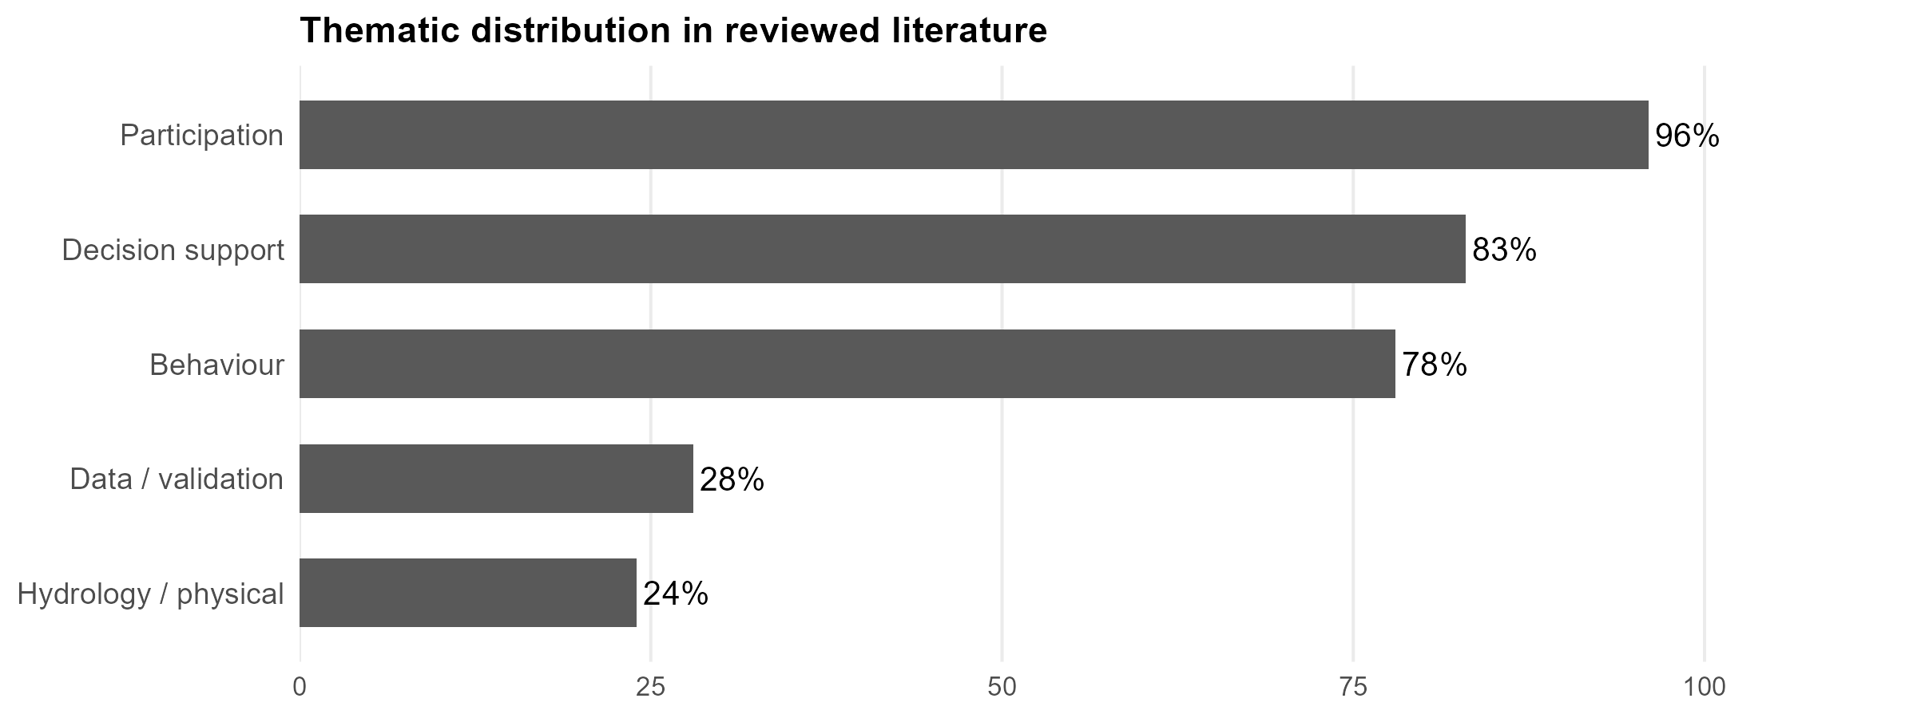
Participation mentioned, not embeded
46
publications
No date restrictions
WoS
Surface-level
Open invitation: help extend and critically review participatory ABM in flooding.

Slide 7
Participation into research design
1
2
3
4
5
Engage
Integrate
Model
Validate
Apply
actors + local knowledge
GIS + hydro + reports
rules + interactions
plausibility + sensitivity
platform + DSS
5
Notes:
State the review conclusion: model components are commonly developed in parallel rather than as an iterative chain. Then make the invitation concrete. You are looking for collaborators who can help broaden databases, refine inclusion criteria and coding, identify overlooked cases, and critically assess what counts as meaningful participation and validation. Invite them to speak to you after the session.

Slide 8
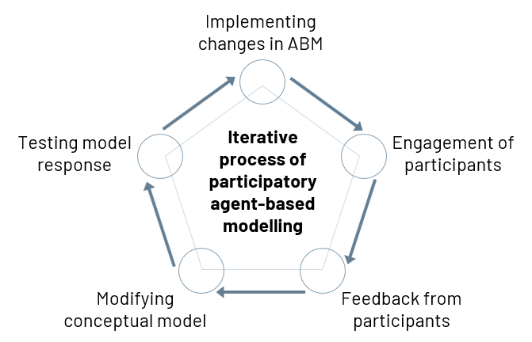
Missing participation into research design
1
2
3
4
5
Engage
Integrate
Model
Validate
Apply
actors + local knowledge
GIS + hydro + reports
rules + interactions
plausibility + sensitivity
platform + DSS
5
Notes:
State the review conclusion: model components are commonly developed in parallel rather than as an iterative chain. Then make the invitation concrete. You are looking for collaborators who can help broaden databases, refine inclusion criteria and coding, identify overlooked cases, and critically assess what counts as meaningful participation and validation. Invite them to speak to you after the session.

Slide 9
LIFE2RIVERS interviews
LOCAL AUTHORITIES (6)
EXPERTS (5)
LOCAL RESIDENTS (6)
EDUCATION SECTOR (3)
responsibility, resources, coordination
system knowledge, ecological constraints
experience, risk perception, self-help
learning, communication, future stewardship

Slide 10
LIFE2RIVERS interviews
LOCAL AUTHORITIES (6)
EXPERTS (5)
LOCAL RESIDENTS (6)
EDUCATION SECTOR (3)
Extract
Translate
Implement
Challenge
actions, triggers, constraints
variables + conditional rules
NetLogo agents + environment
expert plausibility checks

Slide 11
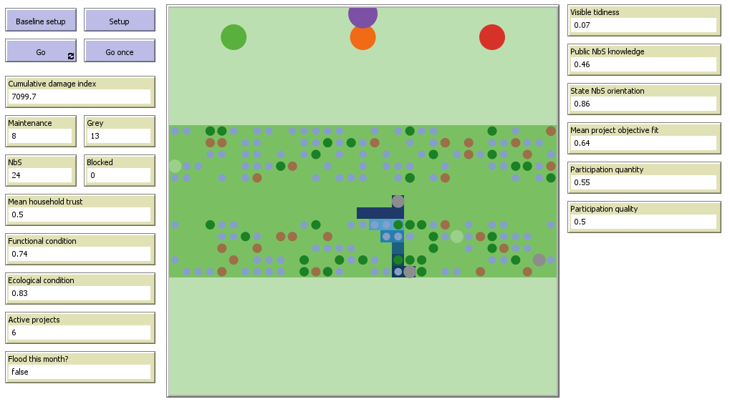
Prototype model: how flood-risk measures are selected and implemented?

Slide 12
Prototype model: how flood-risk measures are selected and implemented?
Agents
Households
Three municipalities with different capacities and approaches
State-level authority
At each monthly step
River and environmental conditions are updated.
Households observe and report local problems.
Municipalities prioritise possible measures.
NbS may require landowner agreement.
Municipalities consider co-financing.
The state reviews a limited number of proposals.
Approved maintenance, grey infrastructure and NbS projects progress.
A flood may occur, affecting damage, trust, risk perception and political pressure.

Slide 13
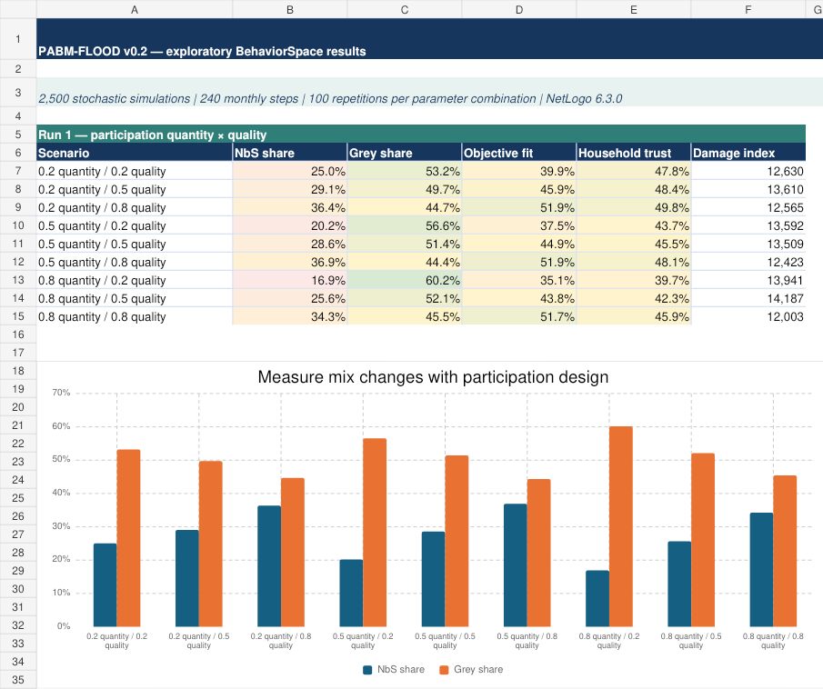
Quick test: Participation quantity vs quality

Slide 14

Going forward
NOW
NEXT
THEN
Project-consortium mock workshop
1–2 stakeholder modelling workshops
Revise + analyse
stress-test roles, rules and facilitation
edit assumptions and test scenarios
empirical checks, sensitivity, platform/DSS
rok.novak@ijs.si

